Slide 1

Exploratory Data Analysis On TVs
Presentation by:- K.Rohith Reddy

Slide 2
Agenda
Business Problem
Problem Statement
Objective
Scraping
Dataset Overview
Data Preparation & Cleaning
Univariant Analysis
Bi-Variant Analysis
Multi-Variant Analysis
Hypothesis Testing
Recommendations
Conclusion

Slide 3
Business Problem:-
Retailers and manufacturers face difficulty understanding customer preferences due to the wide variety of TV specifications, price ranges, and brands in the market. This lack of clarity leads to poor inventory planning, inefficient pricing strategies, and wasted marketing spend on products with low demand.
Problem Statement:-
TV product data is large, inconsistent, and unstructured, making it difficult to extract meaningful insights directly. The challenge is to clean and analyze this data using Exploratory Data Analysis to identify key pricing drivers, popular feature combinations, and weak-performing segments to support data-driven business decisions.

Slide 4
Objective:-
• Analyze pricing variation across brands, screen sizes, resolutions, and other key features.
• Identify which technical specifications most strongly influence customer interest and perceived value.
• Detect trends and patterns in ratings, availability, and product positioning across the market.
• Compare performance across brand segments to highlight leaders and laggards.
• Surface feature combinations that represent the best value for customers and the highest margin potential for sellers.
• Convert messy raw TV data into insights businesses can actually use for stocking, pricing, and strategy.

Slide 5
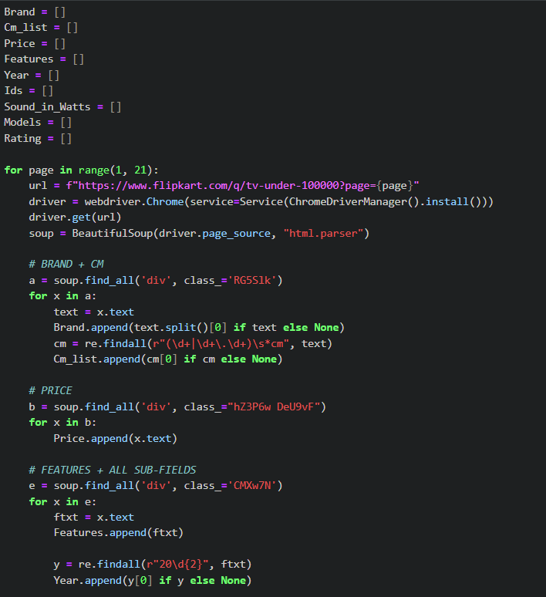
Scarping:-
Sending a Request: The scraper sends a request to a website’s server to access a webpage.
Retrieving HTML Content: The website responds with the HTML, CSS, and JavaScript code of the page.
Parsing Data: Tools like BeautifulSoup, Selenium, extract the desired information from the HTML.
Cleaning & Structuring: Extracted data is cleaned and organized into tables, CSVs, or databases.
Analysis & Visualization: The structured data can then be analyzed or visualized for insights.

Slide 6
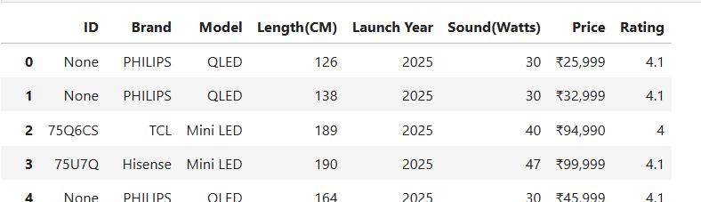
Dataset Overview:-
The data was collected from online TV shopping websites.
It includes TVs from many brands and price ranges.
Each TV has details like brand name, price, and customer rating.
Technical information such as screen size, display type, and sound output is included.
Additional details like launch year and model name are also available.
The dataset shows TVs that are currently sold in the market.

Slide 7
Data Preparation & Cleaning:-
Removed currency symbols and converted price fields to numeric format.
Extracted structured attributes (screen size, resolution, display type) from unstructured text.
Handled missing and inconsistent customer ratings using standard imputation rules.
Standardized data types and units across all feature columns.
Normalized brand and model naming to eliminate duplicates and inconsistencies.
Validated feature ranges and removed invalid or outlier records where necessary.

Slide 8
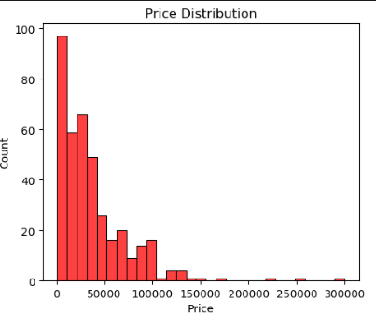
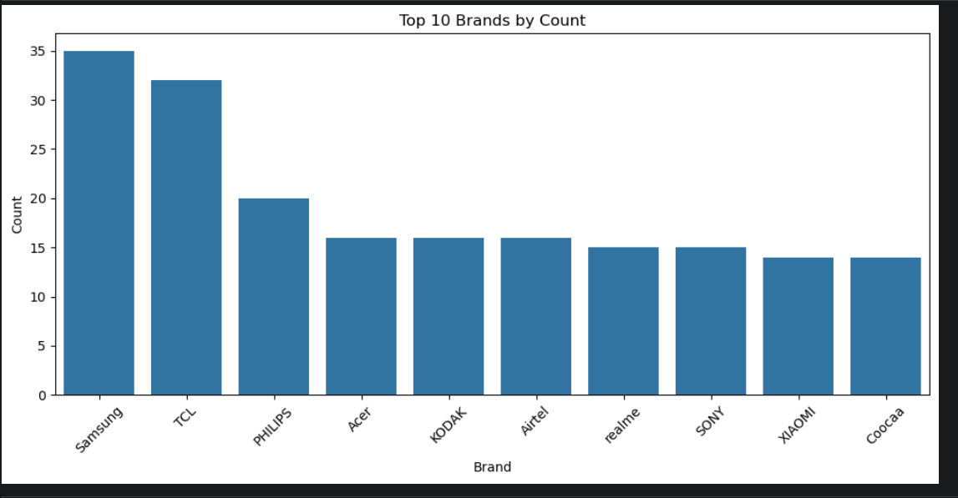
Univariant Analysis:-
TV prices show a strong right-skewed distribution.
Majority of models fall in the ₹10,000–₹50,000 range.
High-end TVs above ₹100,000 appear as rare outliers.
Samsung and TCL dominate the catalogue with the highest number of TV models.
Most other brands have a moderate presence, forming a long competitive tail.
Product availability is concentrated among a few major brands.

Slide 9
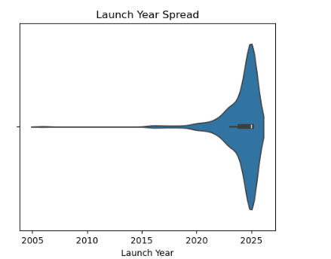
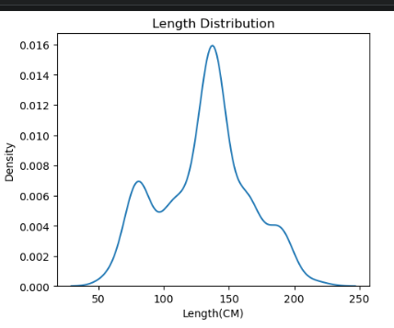
Launch Year Distribution
Majority of TV models were launched between 2020 and 2024.
Peak concentration appears around 2022–2023.
Older models form a negligible tail, indicating focus on recent inventory.
Screen Length Distribution
Screen sizes cluster into standard consumer ranges.
Highest concentration is around 130–150 cm (≈50–55 inches).
Very large screens (above 180 cm) are rare and niche.

Slide 10
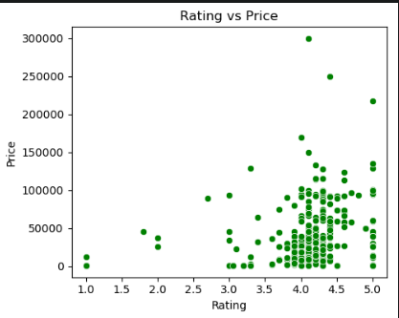
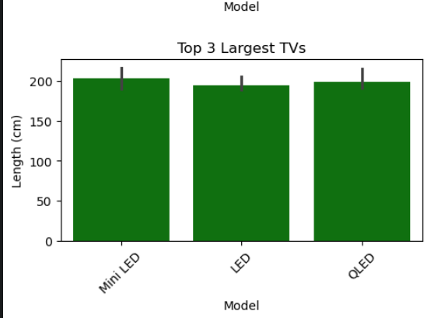
Bi-Variant Analysis:-
Price vs Customer Rating
Ratings remain clustered between 3.5 and 4.5 across prices.
Higher price does not guarantee higher customer satisfaction.
Weak relationship between price and rating.
Screen Length vs Display Type
Premium display types (QLED, Mini LED, OLED) appear in larger screen sizes.
Traditional LED models dominate smaller and mid-size ranges.
Advanced technology is typically paired with bigger panels.

Slide 11
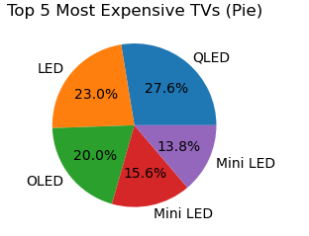
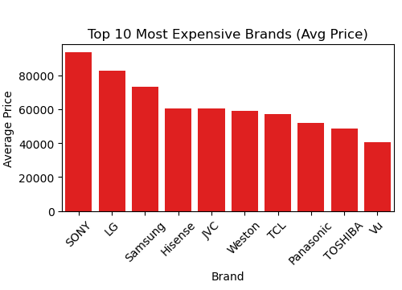
Display Technology Share (Top 5 Expensive TVs)
QLED holds the largest share among the most expensive TVs.
LED and OLED also contribute significantly to the premium segment.
Premium pricing is distributed across multiple display technologies.
Average Price by Brand (Top 10)
Sony leads with the highest average TV prices.
LG and Samsung form the next premium tier.
Other brands compete at comparatively lower price points.

Slide 12
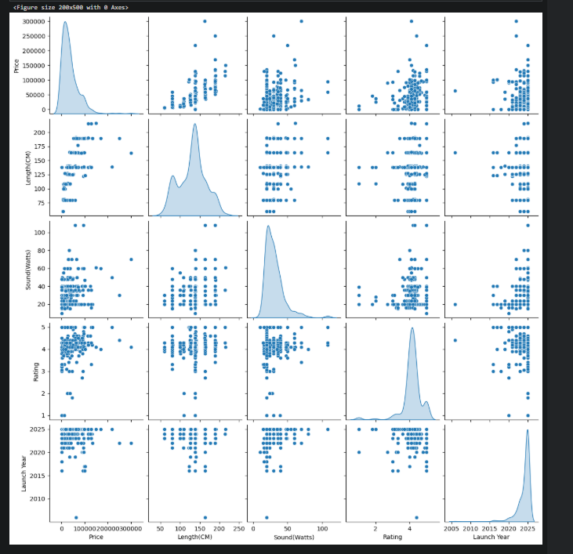
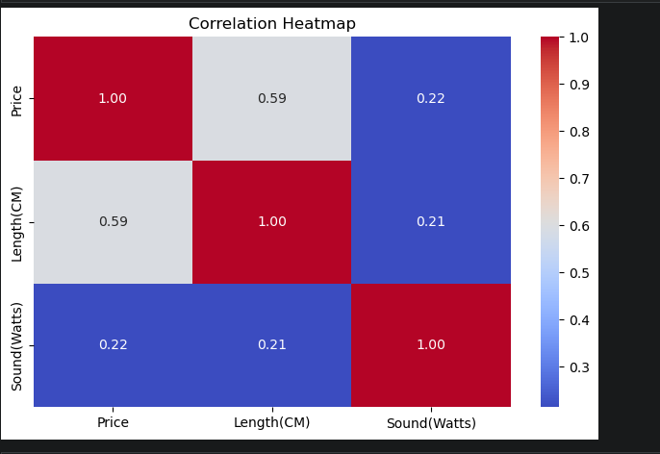
Multi-Variant Analysis:-
Correlation Heatmap
Price and screen length show a moderate positive correlation (0.59).
Price and sound output have a weak relationship (≈0.22).
Screen size impacts price more than audio power.
Pairplot Overview
Larger TVs generally fall into higher price ranges.
Customer ratings remain tightly clustered across features.
Sound output shows no clear influence on price or ratings.

Slide 13
Hypothesis Testing:-
Test 1: Screen Size vs Price
Null Hypothesis (H₀):
Screen size and TV price have no relationship.
Alternative Hypothesis (H₁):
Larger TVs cost more.
Pearson correlation: 0.59
P-value < 0.05
Decision: Reject H₀
Conclusion: Screen size significantly influences price.
Test 2: Screen Size vs Speaker Power
Null Hypothesis (H₀):
Screen size and speaker wattage have no relationship.
Alternative Hypothesis (H₁):
Larger TVs have higher speaker wattage.
Pearson correlation: 0.21
P-value < 0.05
Decision: Reject H₀
Conclusion: Relationship exists but is weak.

Slide 14
Recommendations:-
Focus inventory on 43–55 inch TVs, the highest-demand and revenue-driving segment.
Promote strong-performing brands with consistent presence and ratings.
Expand QLED and Mini LED offerings where margins are higher.
Bundle or upsell external audio systems, since built-in sound adds little value.
Price mid-range models competitively around psychological thresholds (₹30k–₹50k) to capture volume without entering premium price wars.

Slide 15
Conclusion:-
Screen size is the strongest driver of TV pricing.
Customer ratings remain tightly clustered, showing price ≠ perceived quality.
Speaker wattage has minimal influence on price and size.
Market listings are dominated by recent launches.
A few major brands control most of the catalogue, with others competing on value.

Slide 16


